Slide 1
DFS BFS 추가자료

Slide 2
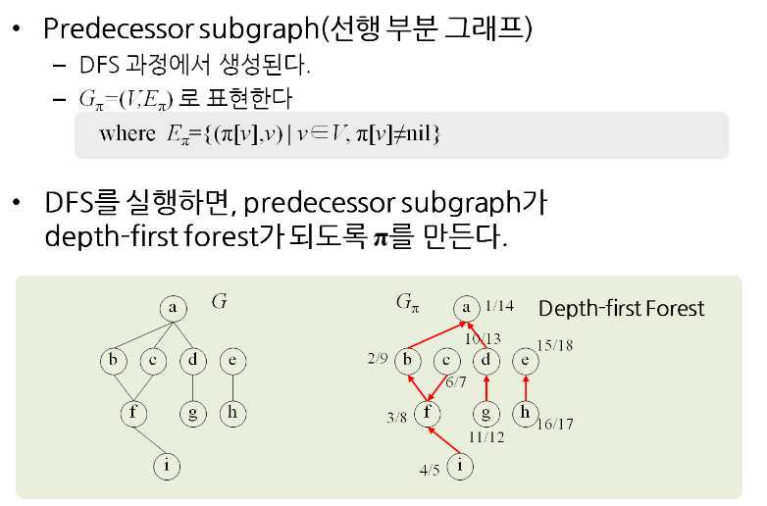
Depth First Forest

Slide 3
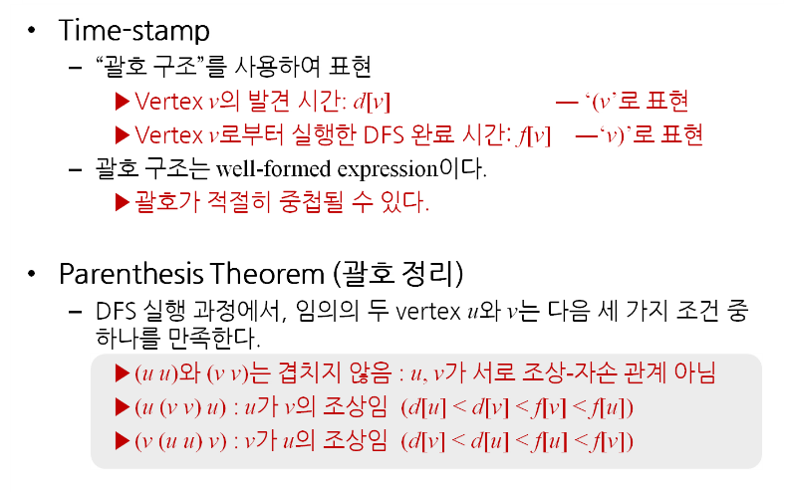
Parenthesis Theorem

Slide 4
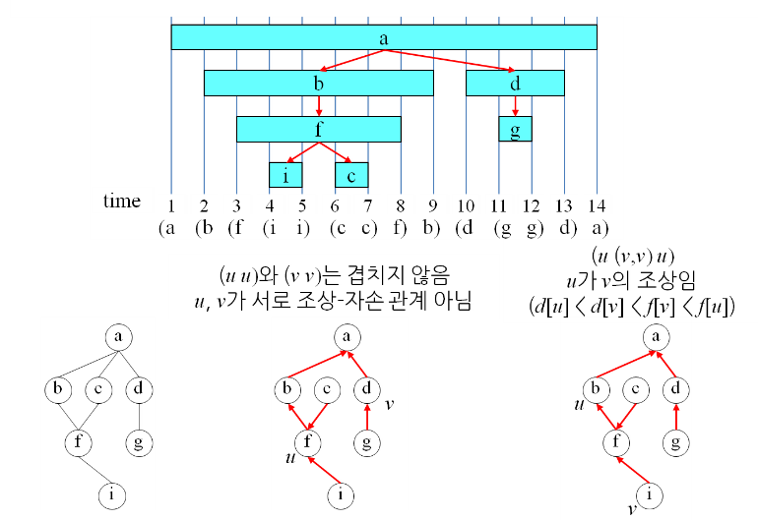
Parenthesis Theorem - 그림

Slide 5
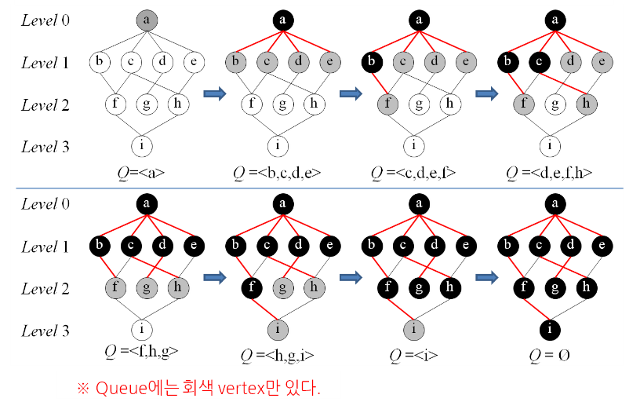
Breadth First Search - 예

Slide 6
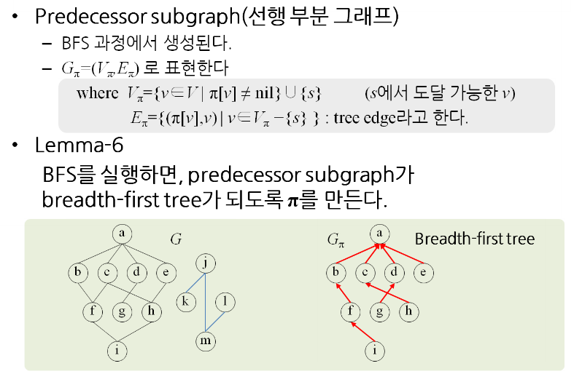
Breadth First Tree

Slide 7
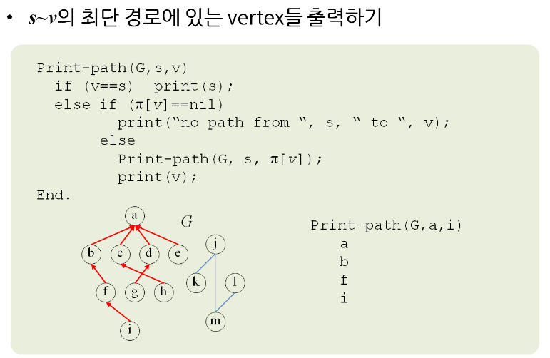
Shortest Path 출력

Slide 8
Branch-and-Bound

Slide 9
Branch and Bound
Branch and bound is an algorithm design paradigm which is generally used for solving combinatorial optimization problems.
These problems typically exponential in terms of time complexity and may require exploring all possible permutations in worst case.
Branch and Bound solve these problems relatively quickly.

Slide 10
0-1 Knapsack – DFS
n = 4, W = 16

Slide 11
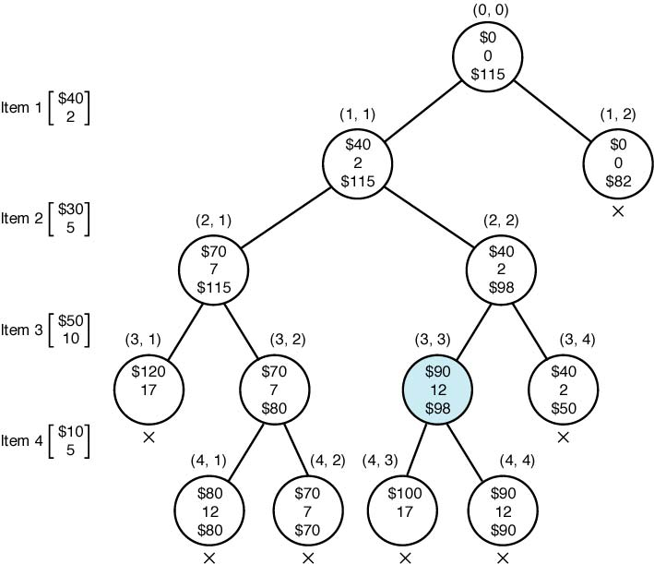
0-1 Knapsack – DFS
profit
n = 4, W = 16
weight
bound
maxprofit = 40
maxprofit = ___
maxprofit = ___
maxprofit = ___
maxprofit = ___
maxprofit = ___
maxprofit = ___
maxprofit = ___
maxprofit = ___
maxprofit = ___
maxprofit = ___

Slide 12
0-1 Knapsack – DFS
profit
n = 4, W = 16
weight
bound
maxprofit = 40
maxprofit = 90
maxprofit = 80
maxprofit = 70
maxprofit = 90
maxprofit = 70
maxprofit = 90
maxprofit = 70
maxprofit = 80
maxprofit = 80
maxprofit = 90
maxprofit = 90

Slide 13
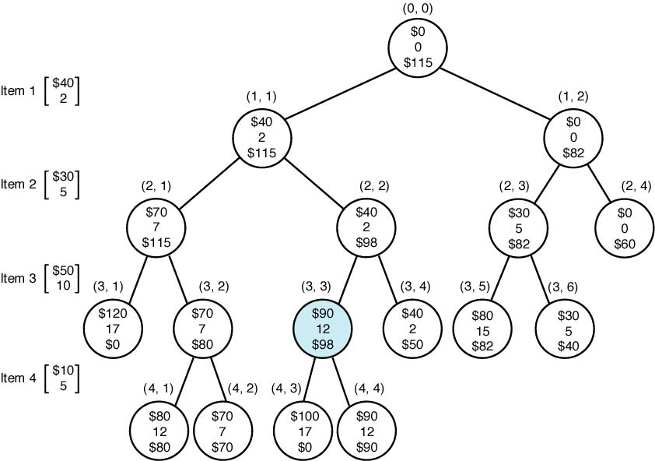
0-1 Knapsack – BFS
profit
weight
bound
mp= 40
mp= 40
mp= 70
mp= 70
mp= 70
mp= 70
mp= 70
mp= 90
mp= 90
mp= 70
mp= 90
mp= 90
mp= 90
mp= 90
mp= 90
mp= 90

Slide 14
0-1 Knapsack – Best FS
Strategies for getting the best answers faster:
Search all of the child nodes of a given node.
Look at the promising and unexpanded nodes.
Expand the node with the best (best) limits.
Use Priority Queue to select nodes with the best bound first. This can be effectively implemented using the Heap.

Slide 15
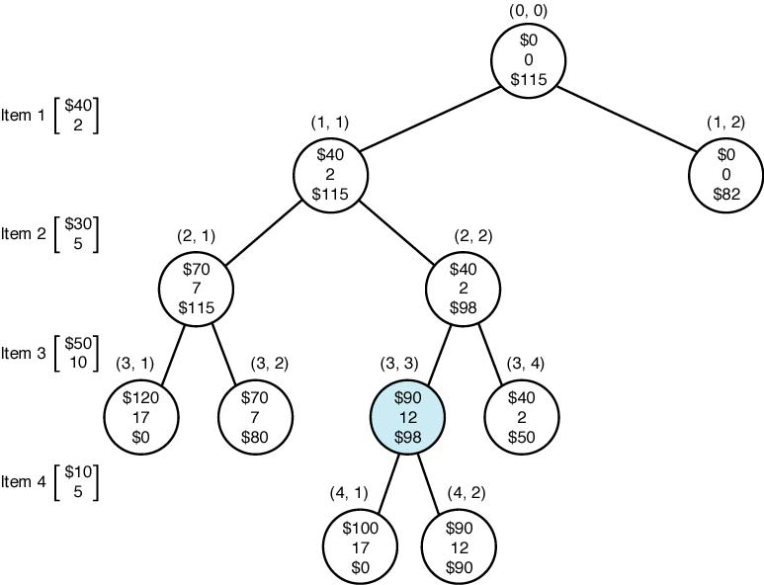
0-1 Knapsack – Best FS
profit
weight
bound
mp= 40

Slide 16
0-1 Knapsack – Best FS
profit
weight
bound
mp= 40

Slide 17
0-1 Knapsack – Best FS
profit
weight
bound
mp= 40
mp= 70

Slide 18
0-1 Knapsack – Best FS
profit
weight
bound
mp= 40
mp= 70

Slide 19
0-1 Knapsack – Best FS
profit
weight
bound
mp= 40
mp= 70
mp= 90

Slide 20
0-1 Knapsack – Best FS
profit
weight
bound
mp= 40
mp= 70
mp= 90
mp= 90

